Slide 1

SMART AGRICULTURE SYSTEM USING IOT
Under the guidance of
Mrs .G. KRANTHI KUMRI, M.Tech
Assistant Professor
By
Alluri Sai Lakshmi 20KH1A0402

Slide 2
CONTENTS
Executive Summary
About Community
Activities
Introduction to IOT
Using of IOT
Mini Project
Conclusion
Photos

Slide 3
EXECUTIVE SUMMARY
The report is about my Internship at Under SkillDzire for 240 Hours. Organized By SkillDzire in collaboration with Andhra Pradesh State Council of Higher Education. In this Comprehensive Report, I have discussed in details about Internet Of Things.
LEARNING OBJECTIVES
Mastery of IOT Concepts: To develop a comprehensive understanding of fundamental principles, architectures, and technologies underlying IOT design and implementation.
Practical Application Skills: To gain hands-on experience in developing, programming, and testing through real-world projects and applications.
OUTCOMES
Proficiency in IOT Development
Problem-solving and Critical Thinking

Slide 4
ABOUT COMMUNITY
The collaboration between SkillDzire and the Andhra Pradesh State Council of Higher Education (APSCHE) signifies a dynamic partnership aimed at fostering skill development and educational advancement within the state of Andhra Pradesh, India. SkillDzire, renowned for its expertise in providing industry-relevant training and internship programs, joins forces with APSCHE, a key governmental body dedicated to enhancing the quality and accessibility of higher education across the state.
E-mail: info@skilldzire.com
Website: https://skilldzire.com/
Associated With: Andhra Pradesh State Council of Higher Education (APSCHE)
Industry: E-Learning Providers
Company size: 11-50 employees
Founded: 2020

Slide 5
ACTIVITIES
WEEK 1 | Introduction to IOT
WEEK 2 | About to use of IOT
WEEK 3 | Mini project
WEEK 4 | Mini project
WEEK 5 | Report Preparation

Slide 6
INTRODUCTION TO IOT
IOT stands for Internet Of Things. It refers to the interconnectedness of physical devices, such as appliances and vehicles, that are embedded with software, sensors, and connected which enables these objects to connect and exchange data. This technology allows for the collection and sharing of data from vast network of devices, creating opportunities for more efficient and automated systems.
IOT is a system of interrelated things, computing devices, mechanical and digital machines, objects, animals, or people that are provided with unique identifies. And the ability to transfer the data over a network requiring human-to-human or human-to-computer interaction.

Slide 7
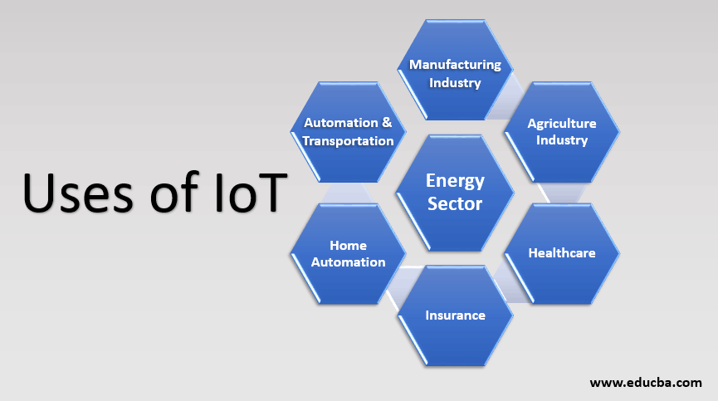
ABOUT TO USE OF IOT
In IOT- based smart farming, a system monitors the crop field using sensors (such as light, humidity, temperature and soil moisture0 and automates the irrigation system. The farmers can monitor the field conditions from anywhere. IOT- based smart farming is highly efficient when compared with the conventional approach.

Slide 8
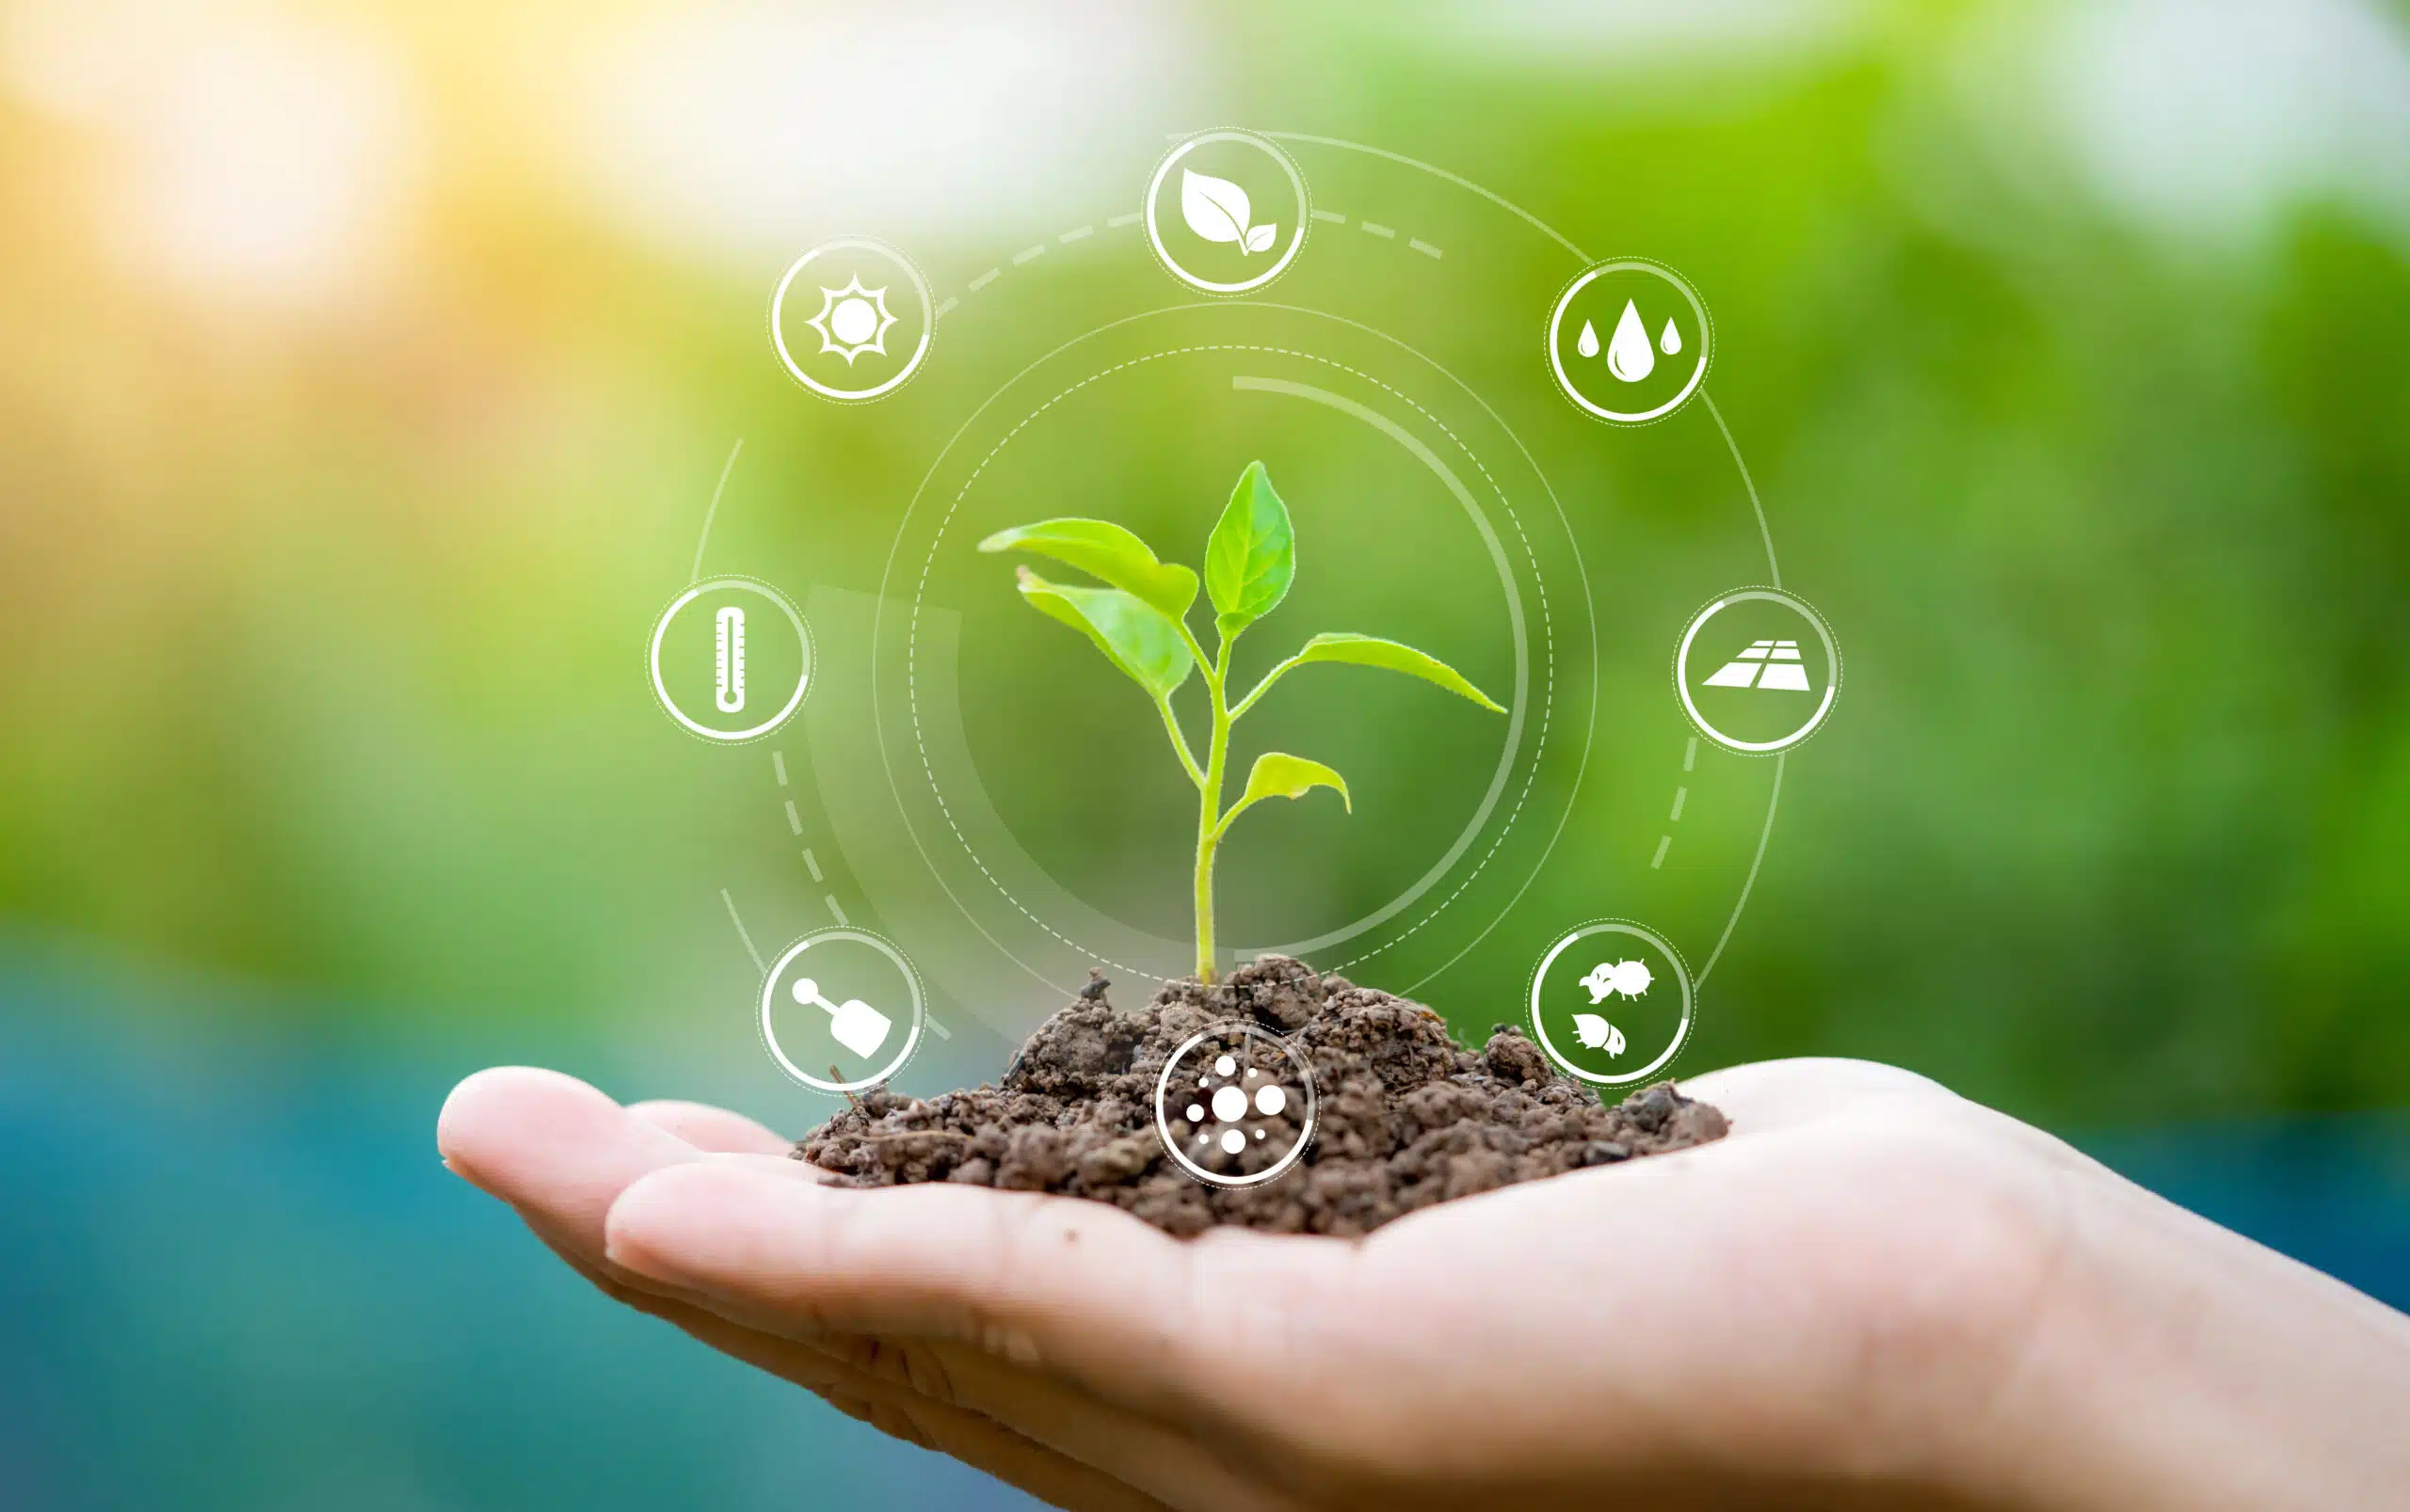
MINI PROJECT
THE ROLE OF IOT IN AGRICULTURE
The internet of things(IOT) is revolutionizing agriculture by connecting sensors, devices, and machinery to collect and analyze data in real-time. IOT enables formers to monitor soil moisture, temperature and crop health remotely, making data-driven decisions for irrigation, fertilization, and pest control. By harnessing IOT, farmers can optimize resource allocation, reduce costs and improve overall form efficiency.

Slide 9
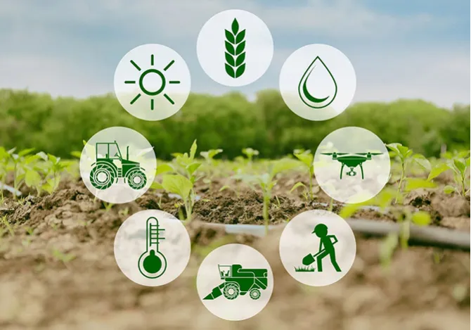
BENEFITS OF IOT IN AGRICULTURE
Increased crop yield and quality through precision farming.
Efficient resource management and
optimization .
Early detection and prevention of
diseases and pests.
Improved decision-making and predictive analytics for farmers.

Slide 10

CONCLUSION
The power of IOT is transforming agriculture into a smart and efficient industry. Embracing these technologies can lead to improved productivity, sustainable practices and a brighter future for farming.

Slide 11
THANK YOU

